Slide 2

Normative accounts of Probability Weighting in Decision Science
Benjamin Skjold Frederiksen
s182848
Involved researchers & personnel
Ollie Hulme, DRCMR, Supervisor
Tobias Andersen, DTU, Supervisor

Slide 3
Agenda
Background and motivation
Probability weighting – what is it?
Probability weighting – how is it tested?
Probability weighting – why does it exist?
Thesis objective
Methods
Experimental design
Model(s)
Simulation study
Results
Future work

Slide 4
Background and motivation Probability Weighting – what is it?
Concept introduced with Prospect Theory (Kahneman & Tversky (1979, 1992))
Non-linear function transforming objective probabilities into people's internal representation of the probability.
Response to examples where expected utility could not explain the general behavior (Allias (1952))

Slide 5
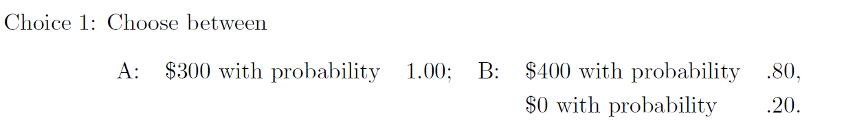
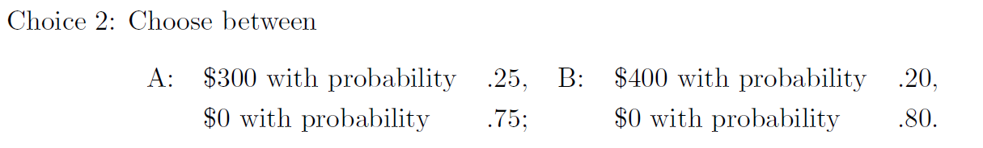
Background and motivation Probability Weighting – what is it?

Slide 6
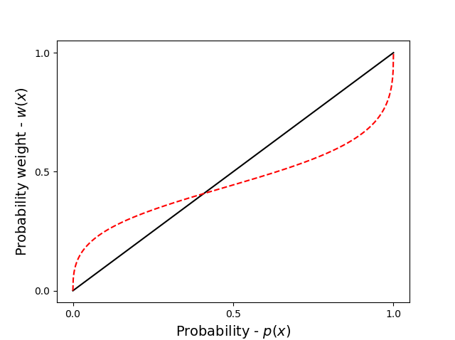
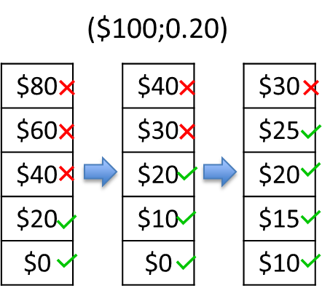

Background and motivation Probability Weighting – How has it been tested?
Decisions from description
Outcome x with probability p
c = 27,5
x = 100
p = 0.2
$$\frac{c}{x}$$
$$p$$

Slide 7
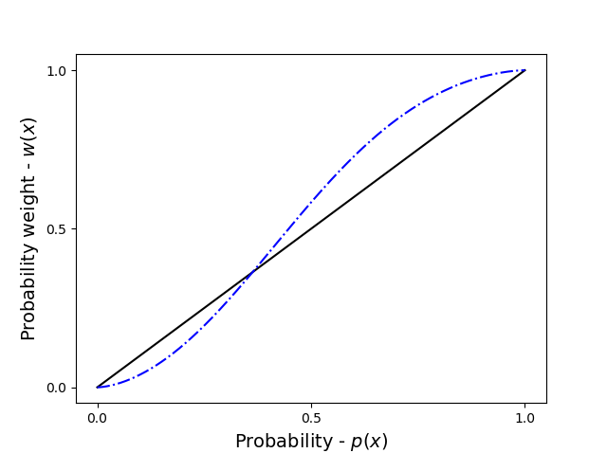
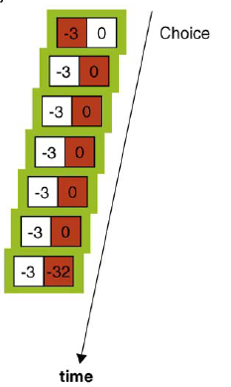
Background and motivation Probability Weighting – How has it been tested?
Decisions from experience
Probabilities and outcomes are not given a priori, but must be learned

Slide 8
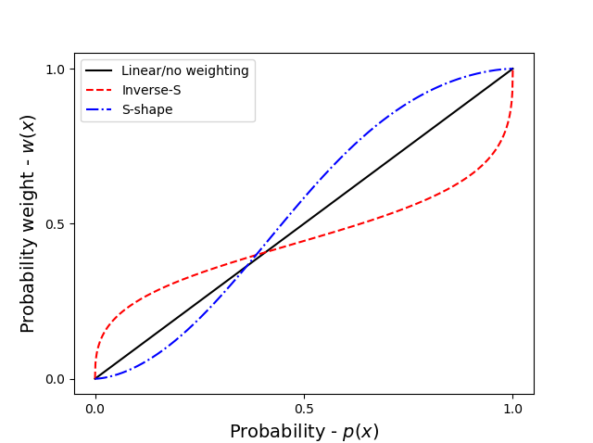
Background and motivation Probability Weighting – what is it?

Slide 9
Background and motivation Probability Weighting – why does it exit?
Descriptive models
Probability weighting is an irrational cognitive bias
Cumulative Prospect Theory (CPT;1992)
Normative models
New theories that seek to provide a normative explanation
Peters et al. (LML;2020)

Slide 10


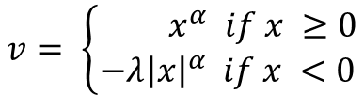
Background and motivation Probability Weighting – why does it exit?
Descriptive models
Probability weighting is an irrational cognitive bias
Cumulative Prospect Theory (CPT;1992)
$$U= Σ v\left(x_{i}\right)w(p_{i})$$
Valuefunction
Weightingfunction
$$v= \left\{\begin{aligned}{ x}^{α} if x ≥0 \\ −λ{\left|x\right|}^{α} if x <0\end{aligned}\right.$$
$$w\left(p\right)= \frac{δp^{γ}}{δp^{γ}+{(1−p)}^{γ}}$$

Slide 11
Background and motivation Probability Weighting – why does it exit?
Descriptive models
Probability weighting is an irrational cognitive bias
Cumulative Prospect Theory (CPT;1992)
$$U= Σ v\left(x_{i}\right)w(p_{i})$$
Weightingfunction
$$w\left(p\right)= \frac{δp^{γ}}{δp^{γ}+{(1−p)}^{γ}}$$

Slide 12
Background and motivation Probability Weighting – why does it exit?
Normative models
New theories that seek to provide a normative explanation
Peters et al. (LML;2020)
“[...] Probability weighting means that a decision maker has greater uncertainty about the world than the observer.”

Slide 13
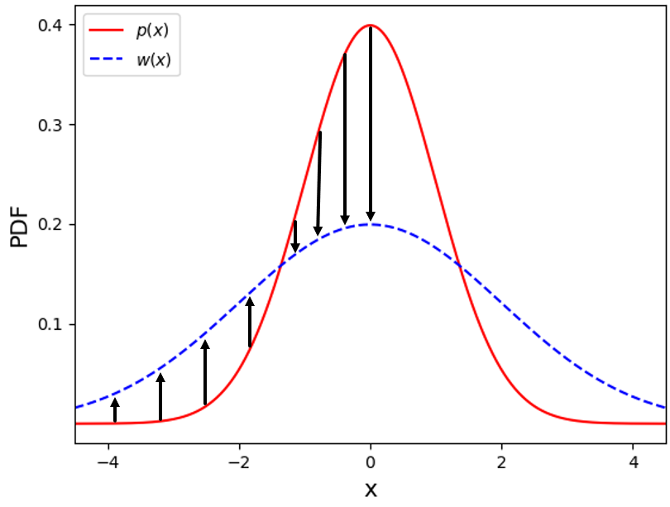
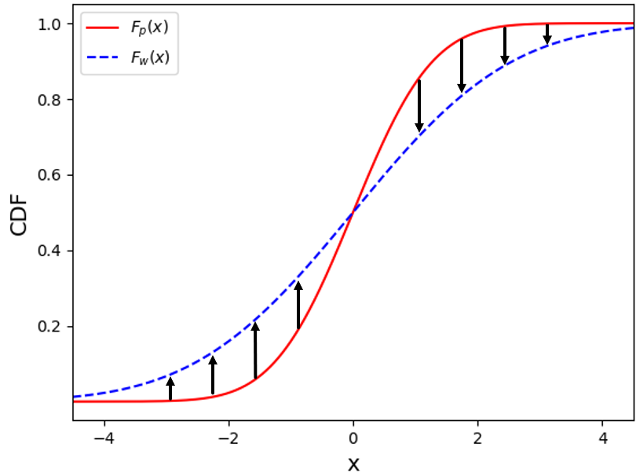
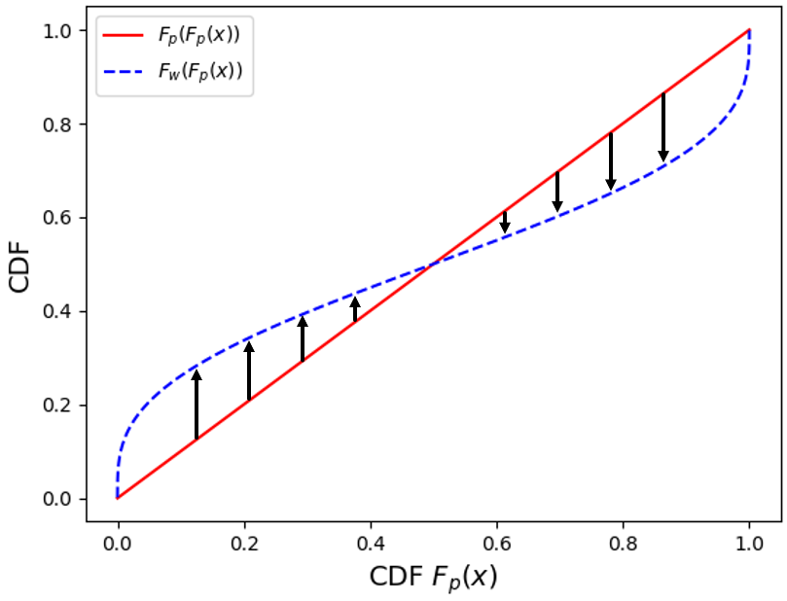
Background and motivation Probability Weighting – why does it exit?
Normative models
New theories that seek to provide a normative explanation
Peters et al. (LML;2020)
Illustrated by example with gaussian noise
Same approximation of x, but decision maker is more uncertain than the observer

Slide 14
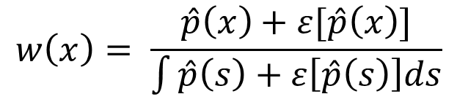
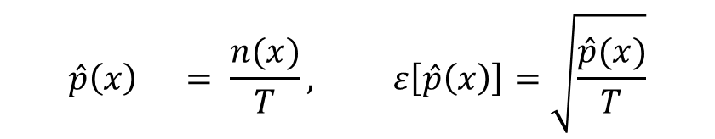
Background and motivation Probability Weighting – why does it exit?
Normative models
New theories that seek to provide a normative explanation
Peters et al. (LML;2020)
$$w\left(x\right)= \frac{\hat{p}\left(x\right)+ε[\hat{p}\left(x\right)]}{\int{\hat{p}\left(s\right)+ε\left[\hat{p}\left(s\right)\right]ds}}$$
$$\hat{p}\left(x\right) = \frac{n(x)}{T}, ε\left[\hat{p}\left(x\right)\right]=\sqrt{\frac{\hat{p}(x)}{T}}$$

Slide 15
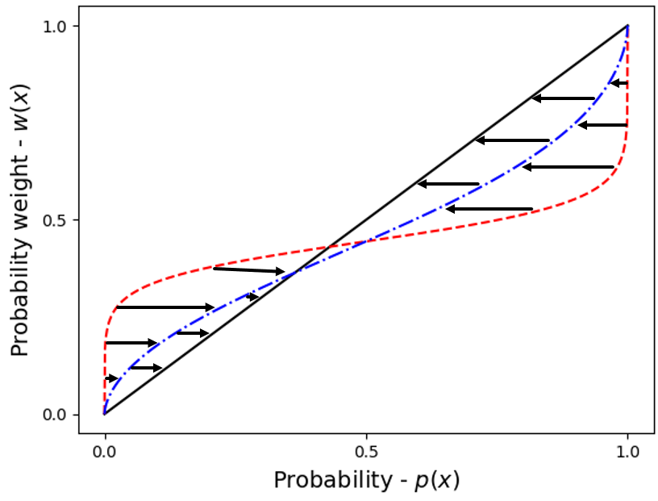
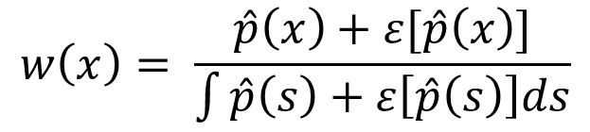
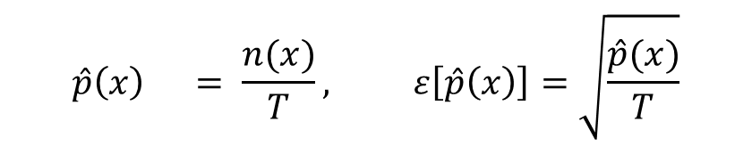
Background and motivation Probability Weighting – why does it exit?
Normative models
New theories that seek to provide a normative explanation
Peters et al. (LML;2020)
$$w\left(x\right)= \frac{\hat{p}\left(x\right)+ε[\hat{p}\left(x\right)]}{\int{\hat{p}\left(s\right)+ε\left[\hat{p}\left(s\right)\right]ds}}$$
$$\hat{p}\left(x\right) = \frac{n(x)}{T}, ε\left[\hat{p}\left(x\right)\right]=\sqrt{\frac{\hat{p}(x)}{T}}$$

Slide 16
Background and motivation Thesis objective
The goal if this project has been to provide insights into the state of the art literature within Probability weighting, by providing a modeling framework that effectively discriminates between Qualitatively different models of probability weighting.

Slide 17
Background and motivation Thesis objective
Do the subjective representations of probabilities in experience-based choices behave non-linearly
- and if so how?
Does this subjective representation change over time with respect to the actually experienced frequencies
- and if so how?

Slide 18
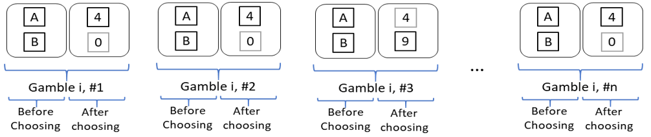
Methods Experimental design
Decisions from experience (Full feedback paradigm)
Example below: A = ($4,1.0), B = ($9,0.2)

Slide 19
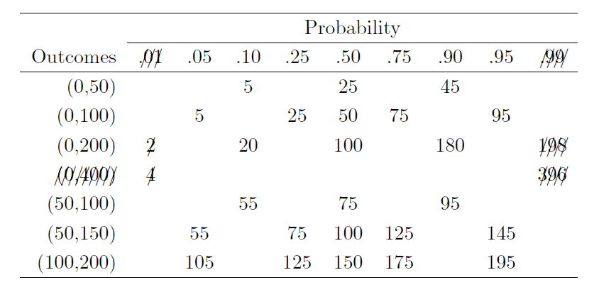
Methods Experimental design
Gamble sets used (Tversky & Kahnemann (1992))

Slide 20
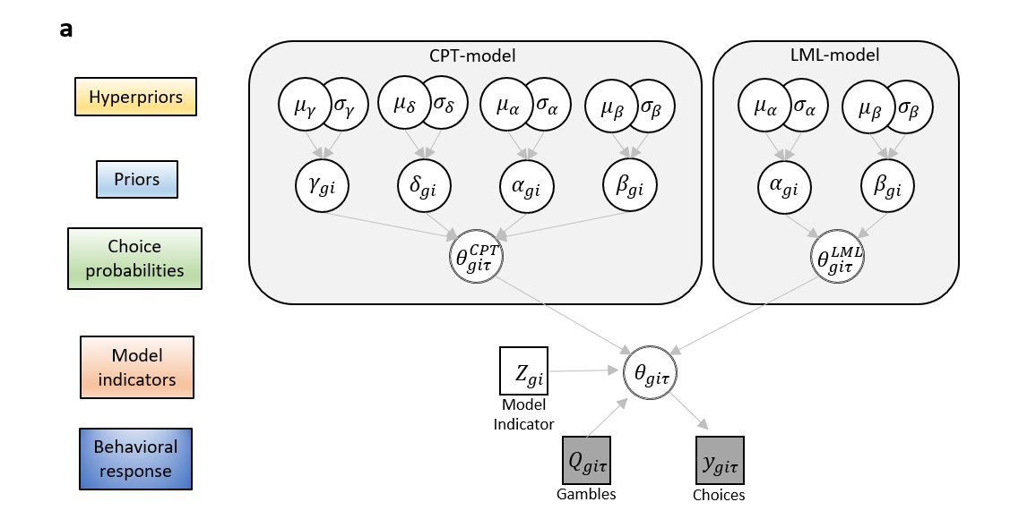
Methods Model(s)

Slide 21
Methods Simulation study
Simulating synthetic agents
Parameter recovery
Model recovery

Slide 22
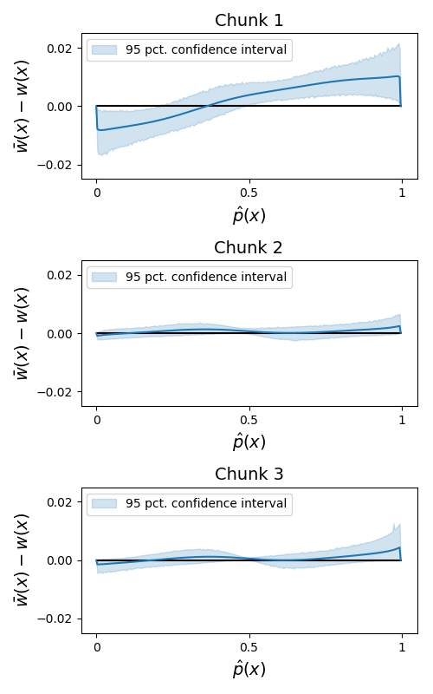
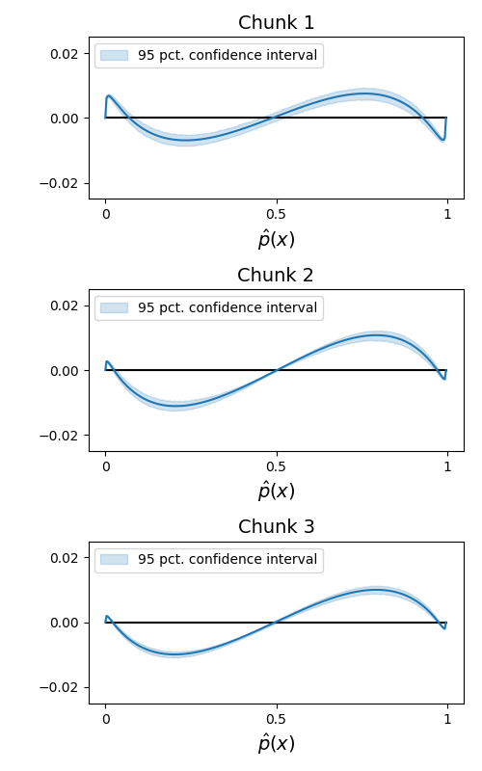
Results Parameter recovery – estimation error
CPT-agents
LML-agents

Slide 23
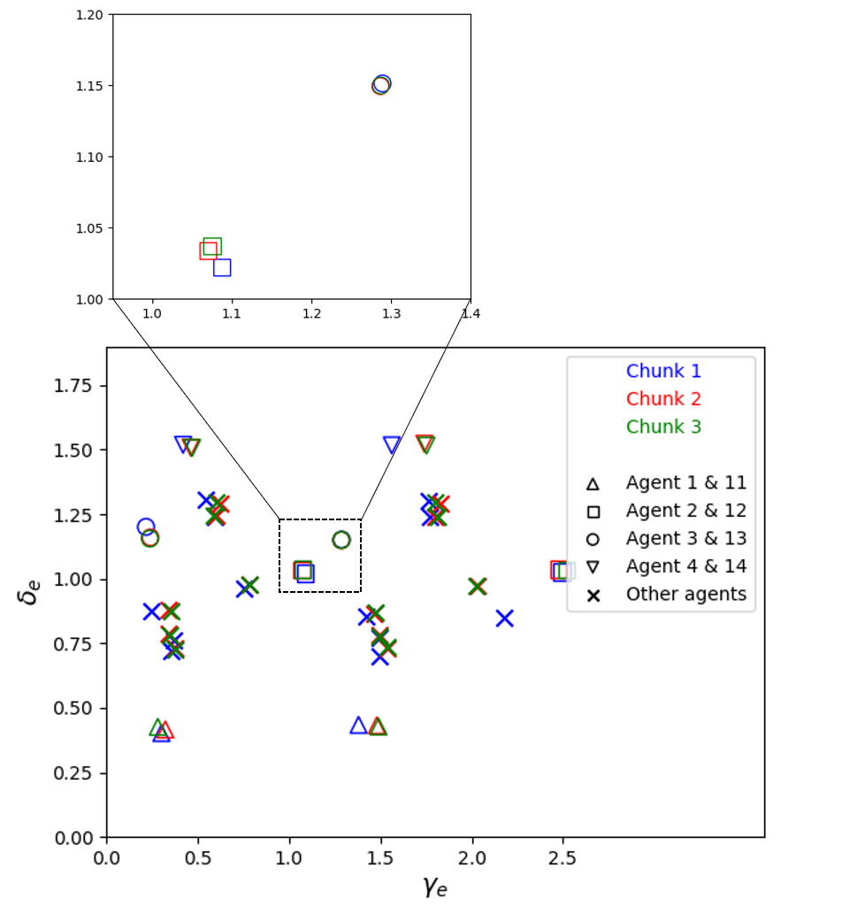
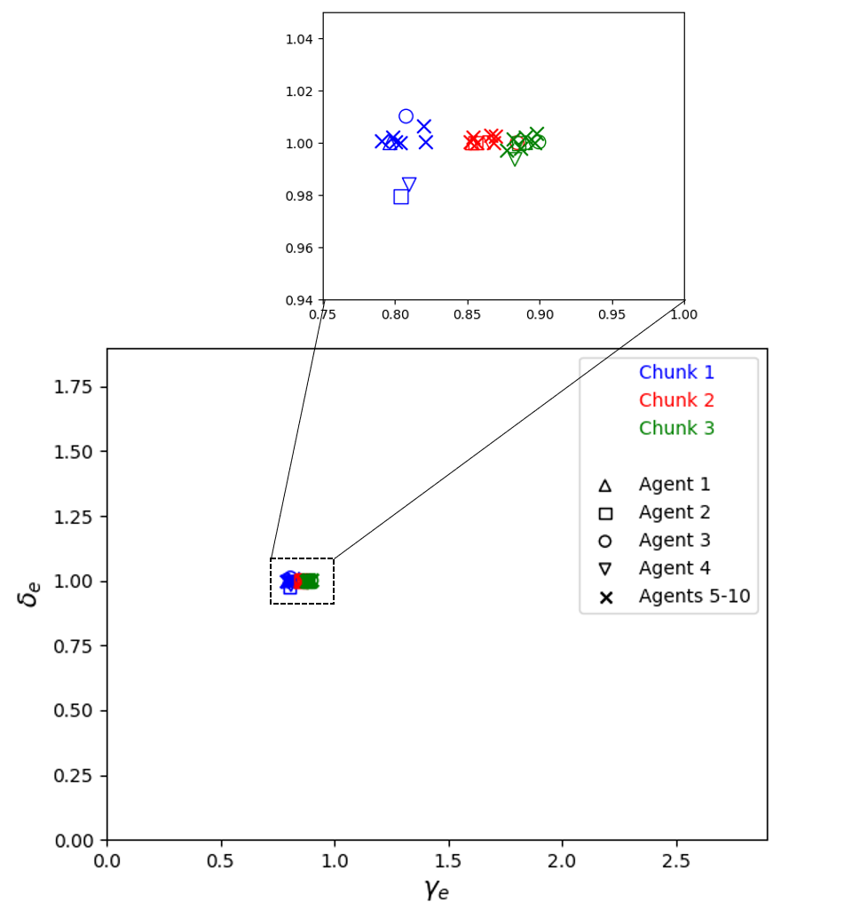
Results Parameter recovery – Probability weighting function
CPT-agents
LML-agents

Slide 24
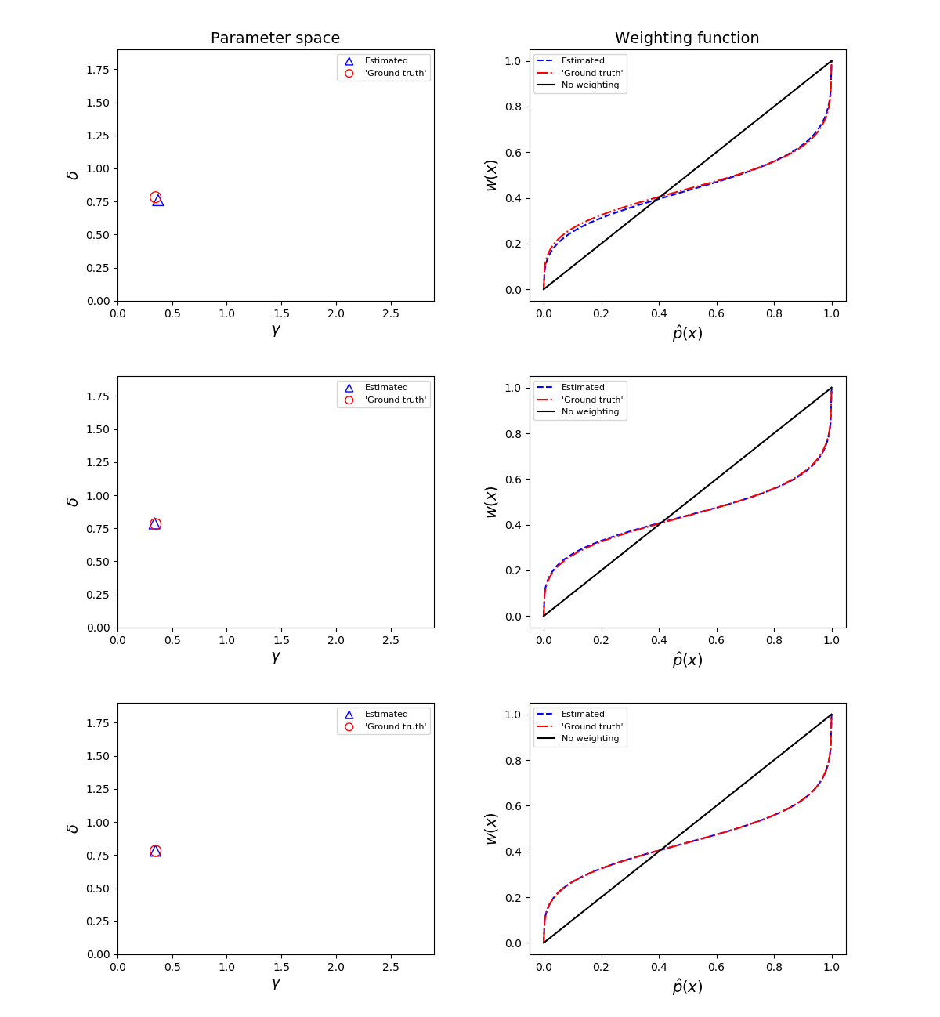
Results Parameter recovery – Probability weighting function

Slide 25
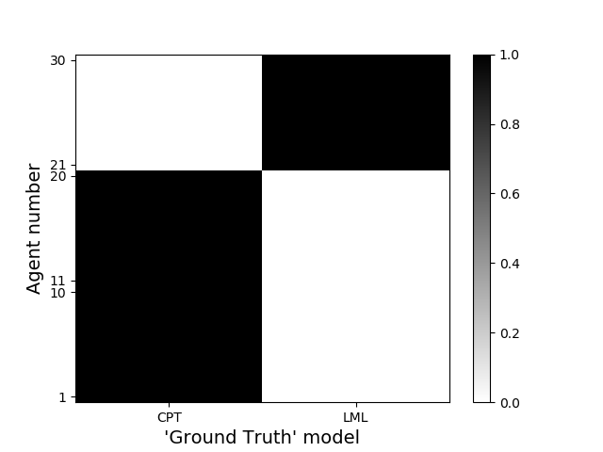
Results Model recovery

Slide 26
Future work
I have shown that there is a disagreement between the two types of theory that are easily drawn about through simple experiments
Further investigations into normative accounts of Probability Weighting
Experimental studies with human subjects
Cortical representation mapping of probability

Slide 27
Normative accounts of Probability Weighting in Decision Science
Benjamin Skjold Frederiksen
s182848
Involved researchers & personnel
Ollie Hulme, DRCMR, Supervisor
Tobias Andersen, DTU, Supervisor

Slide 28
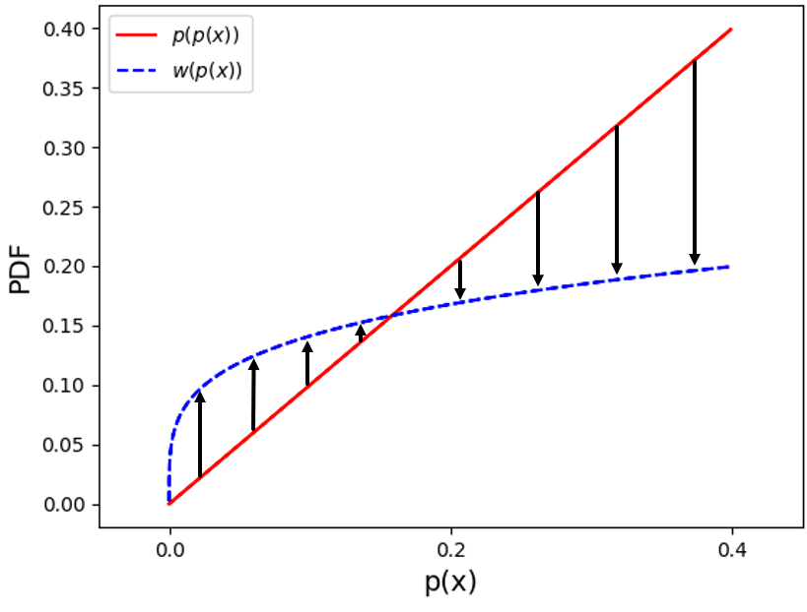
Extra figures

Slide 29
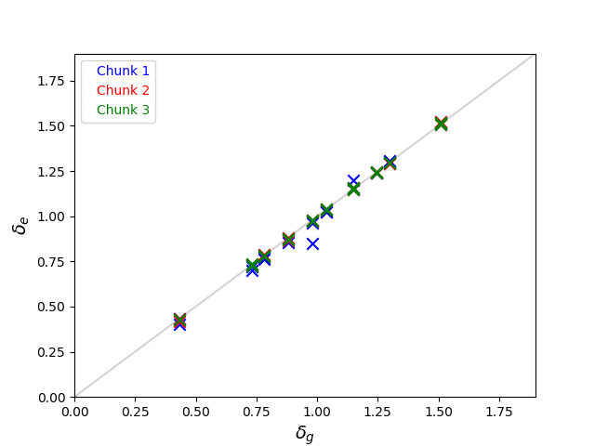
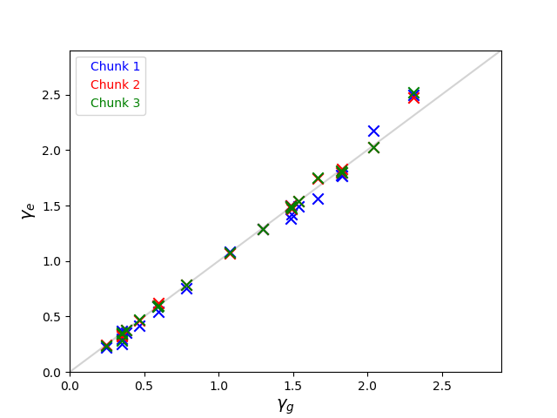
Extra figures
Delta
Gamma

